Slide 1
MSDS 6371 Project
By: Sue Camara
Class: DS-6371
Statistical Foundations for Data Science
Date: August 3rd, 2025

Slide 2
ANALYSIS 1: Model Sale Price - GrLivArea by Neighborhood
Model Objective:
Century 21 Ames requested an analysis of how living area (in 100 sq ft units) impacts sale price in three neighborhoods: NAmes, Edwards, and BrkSide. The goal was to determine whether the relationship between square footage and price differs by neighborhood.

Slide 3

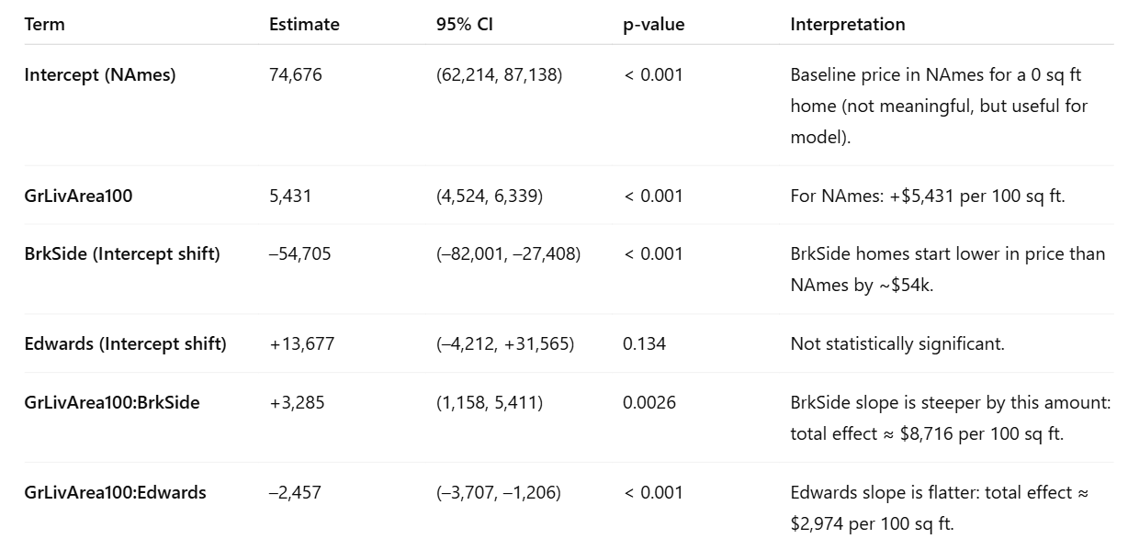
Model Summary
We fit the following model:

Slide 4
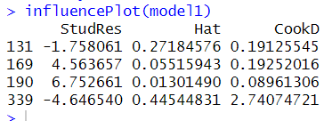
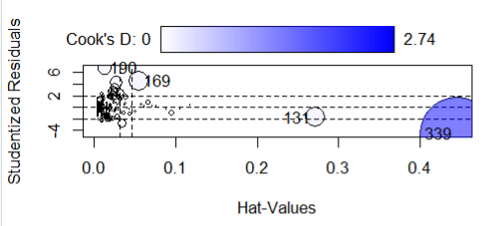
Model Assumptions & Visualizations
Observation 339 is a high-leverage and highly influential point. It has a Hat value = 0.445 (very high) and Cook’s D = 2.74, suggesting it has strong influence on the model’s fit.
Observation 190 has an extremely large residual. It shows a Studentized Residual = 6.75, indicating it deviates significantly from the model prediction, though its leverage is low.
Observation 169 is a potential outlier with moderate influence. It has a Studentized Residual = 4.56 and a non-negligible Cook’s D = 0.19, indicating moderate influence on the regression.
Observation 131 has high leverage but low residual. With a Hat value = 0.27, it’s structurally unusual in terms of predictor values but its residual (–1.76) suggests it isn’t highly problematic alone.

Slide 5
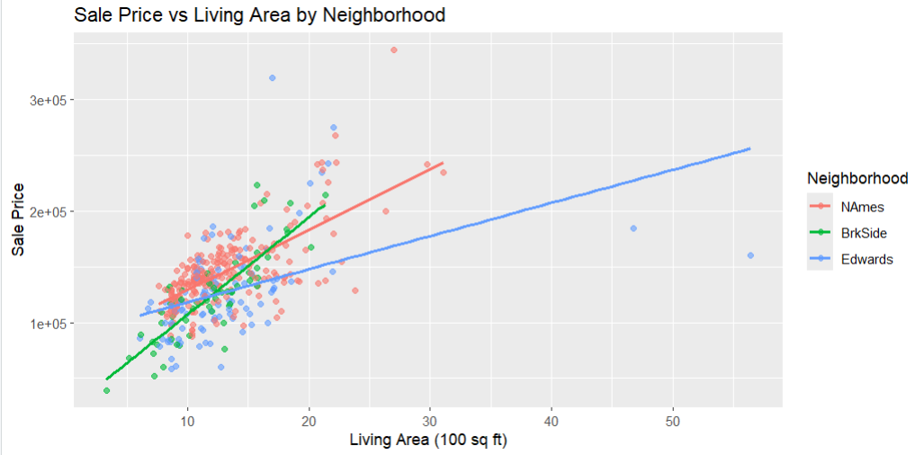
Model Assumptions & Visualizations
Positive Linear Relationships Across All Neighborhoods
In each of the three neighborhoods (NAmes, BrkSide, Edwards), Sale Price increases as Living Area increases, indicating strong positive associations.
Neighborhood-Specific Slopes Differ
BrkSide (green) shows the steepest slope, suggesting home prices rise more sharply with added square footage. Edwards (blue) has the flattest slope, meaning price increases more slowly with additional space. NAmes (red) falls in between.
Different Price Ranges for Similar Sizes
For homes of similar sizes (e.g., around 15–20 hundred sq ft), BrkSide homes tend to be priced higher, while Edwards homes tend to be priced lower, emphasizing location-based price variation.
Outliers Present
A few extremely large homes in Edwards (blue) show much higher living area but relatively low prices, likely contributing to the flattened regression line and warrant further inspection.

Slide 6
Conclusion
In the NAmes neighborhood, homes typically increase in price by about $5,400 for every additional 100 square feet of living space. In BrkSide, the value added is even higher. around $8,700 for the same amount of extra space. On the other hand, homes in Edwards see a smaller boost of about $3,000 per 100 square feet. This shows that the neighborhood makes a big difference in how much extra space adds to a home's price. As a result, real estate pricing should be adjusted based on where the home is located, not just how big it is. We also noticed a few unusual homes in the data that could be affecting the results. These specific cases (IDs: 169, 190, and 339) should be looked at more closely to make sure the final price estimates are accurate and fair.

Slide 7
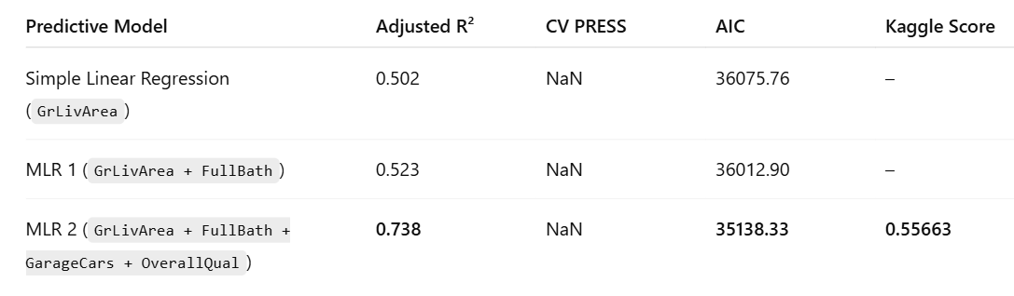
ANALYSIS 2 Model Comparison Table

Slide 8
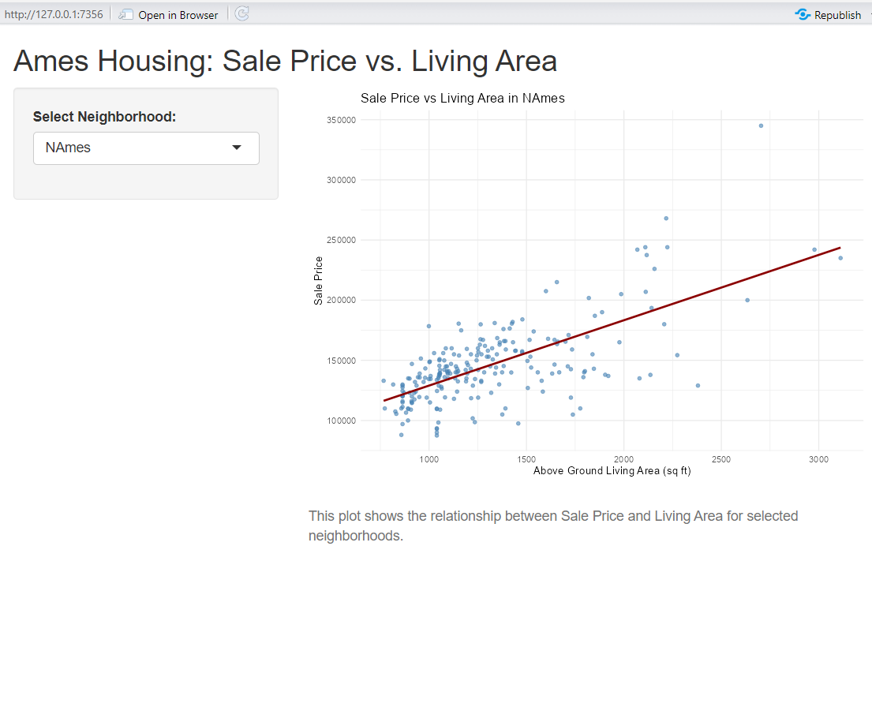
Shinny R App

Slide 9
Analysis 2 Conclusion
The final multiple regression model significantly outperformed the simpler alternatives. Including variables for garage capacity and overall quality added meaningful predictive power beyond living area and bathrooms alone. Our Kaggle score of 0.55663 confirms that a well-built multiple linear regression model, even without advanced techniques, can make accurate price predictions in this dataset. This model is recommended for future use in predicting home values in Ames, especially as a baseline against which more complex methods can be compared.

Slide 10
GitHub Repo
This repository includes the projects final R Markdown File
https://github.com/AnsarSultanaX/FinalProject.git

